Slide 1
Registration of Medical Images
MRI and Mammography
of Breast Cancer

Slide 2
Goal
Today, surgeries are performed "blindly" as a result, a situation arises where the surgeons miss the margins of the tumor or remove too much of the breast tissue, and we come to solve this problem by giving the surgeon more precise parameters regarding the geometry of the tumor.
Notes:
מטרת הפרויקט:
היום ניתוחים נעשים בצורה "עיוורת" כתוצאה מכך נוצר מצב שבו המנתחים מפספסים שוליים או מורידים יותר מידי ואנחנו באים לפתור את הבעיה הזו על ידי זה שאנחנו נותנים לרופא פרמטרים מדויקים יותר לגבי הגיאומטריה של הגידול.
כיום ישנן שתי בעיות בניתוחים של הסרת גידולים, בפרט בסרטן השד מאחר והמנתח עובד בצורה "עיוורת", כלומר אין לו את היכולת לדעת את הגודל המדויק של הגידול יכולים לקרות שני דברים:
הרופא מסיר חלק מהגידול ואז נשארים שוליים סרטניים.
הרופא מסיר יותר מידי רקמות כולל רקמות בריאות ואז אין מספיק רקמות על מנת לבצע ניתוחים אסתטיים אחר כך, אין למנתח עם מה לעבוד אחר כך כשהוא ירצה לעשות שיקומים לשד.
כיום, לפני הניתוח עצמו מוחדר חוט תיל מונחה רנטגן על מנת להבין איפה נמצא הגידול, והמנתח הולך לפי החוט כך שהוא יודע הכין הגידול אך לא את הגבולות שלו.
הרעיון בפרויקט שלנו הוא למצוא את הגבולות בצורה מדויק, ולאחר מכן להשליך את זה בצורה של Augmented Reality על החולה כדי לעזור למנתח בזמן הניתוח.
הניתוח הגיאומטרי של הגידול נאסף באמצעות הממוגרפיה וה – MRI, תוך שילוב של שני הכלים האלו יחד בצורה כזו שמלבישים את התמונות אחת על גבי השנייה וביצוע רגיסטרציה

Slide 3
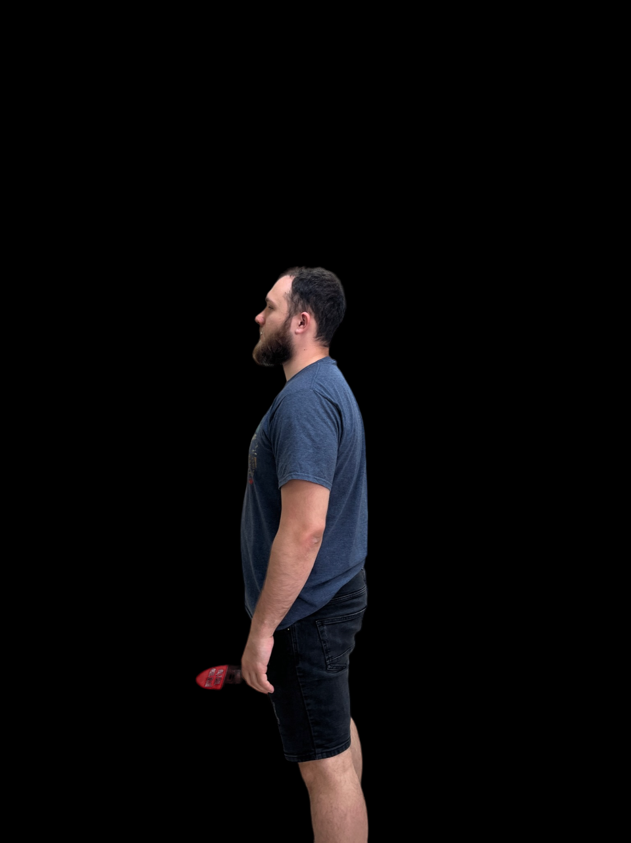
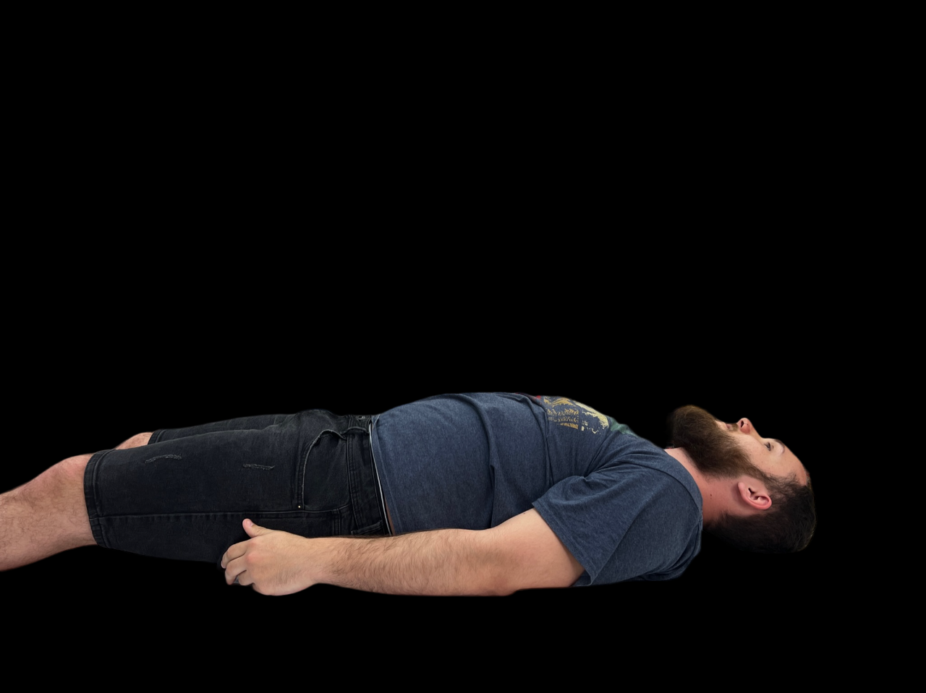
What is New in Our Project?
The significant innovation we made in the project is the addition of a dimension to the error calculation of our model. The training is done on the transformation we are trying to do and on the "target" images, which in our case are the final position - lying on the back.
Original image
Artificial transformation of 90 degrees
Target image
Notes:
מה חידשנו בפרויקט?
החידוש המשמעותי שעשינו בפרויקט הוא תוספת ממד לחישוב הטעות של המודל שלנו. הלימוד נעשה על הטרנספורמציה שאנחנו מנסים לעשות וגם על התמונות "מטרה" שבמקרה שלנו הן המנח הסופי – שכיבה על הגב.
בחישוב הטעות הייתה חלוקה של הלימוד גם לטרנספורמציה וגל לתמונות המטרה. החישוב נעשה בצורה רנדומלית כך ש25% מהזמן אנחנו לומדים מהטרנספורמציה של ה90 מעלות שעשינו באופן מלאכותי וב75% מהזמן אנחנו לומדים מתמונת "המטרה" האמיתית שהיא התמונה של השכיבה על הגב.

Slide 4
Introduction
Results
The approach that yielded the best results involved developing a custom network tailored to the unique data set we collected during this study.
Notes:
הגישה שהניבה את התוצאות הטובות ביותר כללה פיתוח של רשת מותאמת אישית המותאמת למערך הנתונים הייחודי שצברנו במהלך המחקר הזה.
השווינו שלושה סוגי תוצאות:
1. טרנספורמציה קבועה המסובבת את התמונה המקורית ב-90 מעלות.
2. תמונה המבוססת על התמונה המקורית שעברה טרנספורמציה באמצעות הפרמטרים שנלמדו על ידי הרשת.
3. תמונת התוצאה של הרשת.
הערכנו את התוצאות על-ידי שימוש בשגיאה מרובעת ממוצעת ( (MSEוב- Normalized Cross Correlation (NCC) כדי להשוות אותם לתמונה ה"מטרה" המקורית. באמצעות השוואה זו שנערכה על מערך הבדיקות שלנו, קבענו ש"net-grid sample", כפי שמתואר באיור לעיל, הניב את התוצאות הטובות ביותר מבחינת שני הקריטריונים.

Slide 5
Introduction
Breast cancer
Expansion on the project process, data collection, research execution and additional explanations.
Breast cancer is the most common cancer among women worldwide. For these women, breast conservative surgery combined with radiotherapy has become the standard treatment. However, up to 25% of the cases may have a positive pathologic margin, which results in a high rate of re-operations with their accompanying morbidity and risks.
Notes:
הרחבה על תהליך הפרויקט, איסוף הדאטה, ביצוע המחקר במחברת והסברים נוספים.

Slide 6
Introduction
Breast cancer
Surgeries
Research
Breast cancer is the most common cancer among women worldwide. For these women, breast conservative surgery combined with radiotherapy has become the standard treatment. However, up to 25% of the cases may have a positive pathologic margin, which results in a high rate of re-operations with their accompanying morbidity and risks.
On the other hand, sometimes surgeons may excise considerable amounts of healthy tissue, thus limiting the ability to achieve adequate cosmesis. A method to precisely identify the location and geometry of cancer lesions, considering the specific posture and the image statistics of each individual patient, will provide a much greater probability of a well-planned and successful surgery.
This project is a research on MRI-Mammogram registration (imaging-based and sensor-based), which is part of an end-to-end framework. We expect that the impact of such a project will be highly significant, including fewer re-operative procedures, minimizing costs, hospitalization days, and surgery complications.

Slide 7
Introduction
Breast cancer
Surgeries
Research
Breast cancer is the most common cancer among women worldwide. For these women, breast conservative surgery combined with radiotherapy has become the standard treatment. However, up to 25% of the cases may have a positive pathologic margin, which results in a high rate of re-operations with their accompanying morbidity and risks.
On the other hand, sometimes surgeons may excise considerable amounts of healthy tissue, thus limiting the ability to achieve adequate cosmesis. A method to precisely identify the location and geometry of cancer lesions, considering the specific posture and the image statistics of each individual patient, will provide a much greater probability of a well-planned and successful surgery.
This project is a research on MRI-Mammogram registration (imaging-based and sensor-based), which is part of an end-to-end framework. We expect that the impact of such a project will be highly significant, including fewer re-operative procedures, minimizing costs, hospitalization days, and surgery complications.

Slide 8
Introduction
Goal
We propose a non-invasive method for precise cancer analysis to improve surgical success. Our framework focuses on adjusting the patient’s posture to ensure accurate tumor removal. This project aims to reduce re-operations, costs, hospitalization days, and surgery complications through an Augmented Reality application.
Breast cancer
Surgeries
Research
Breast cancer is the most common cancer among women worldwide. For these women, breast conservative surgery combined with radiotherapy has become the standard treatment. However, up to 25% of the cases may have a positive pathologic margin, which results in a high rate of re-operations with their accompanying morbidity and risks.
On the other hand, sometimes surgeons may excise considerable amounts of healthy tissue, thus limiting the ability to achieve adequate cosmesis. A method to precisely identify the location and geometry of cancer lesions, considering the specific posture and the image statistics of each individual patient, will provide a much greater probability of a well-planned and successful surgery.
This project is a research on MRI-Mammogram registration (imaging-based and sensor-based), which is part of an end-to-end framework. We expect that the impact of such a project will be highly significant, including fewer re-operative procedures, minimizing costs, hospitalization days, and surgery complications.

Slide 9
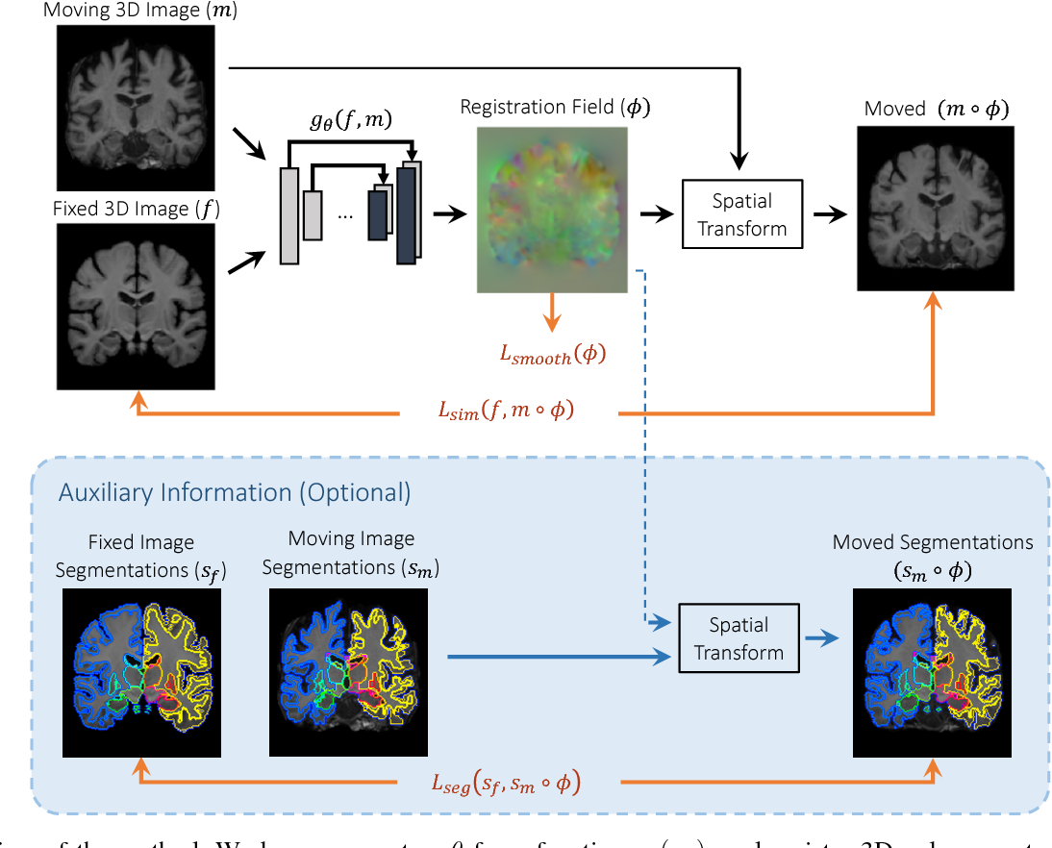
Goal
Methods
We propose a non-invasive method for precise cancer analysis to improve surgical success. Our framework focuses on adjusting the patient’s posture to ensure accurate tumor removal. This project aims to reduce re-operations, costs, hospitalization days, and surgery complications through an Augmented Reality application.
Our research involved the utilization of two key packages: VoxelMorph and PoseNet , but eventually, we built our own neural network using the PyTorch library. Our attempts with the VoxelMorph package and the U-net architecture yielded limited success. So, we built a new network.

Slide 10
Goal
Methods
We propose a non-invasive method for precise cancer analysis to improve surgical success. Our framework focuses on adjusting the patient’s posture to ensure accurate tumor removal. This project aims to reduce re-operations, costs, hospitalization days, and surgery complications through an Augmented Reality application.
Solution Description
Our research involved the utilization of two key packages: VoxelMorph and PoseNet , but eventually, we built our own neural network using the PyTorch library. Our attempts with the VoxelMorph package and the U-net architecture yielded limited success. So, we built a new network.

Slide 11
Methods
Solution Description
Our research involved the utilization of two key packages: VoxelMorph and PoseNet , but eventually, we built our own neural network using the PyTorch library. Our attempts with the VoxelMorph package and the U-net architecture yielded limited success. So, we built a new network.
Data Augmentation
Our Network
VoxelMorph
Unet

Slide 12
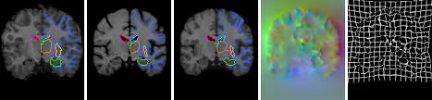
A package developed for learning-based image registration, leveraging the U-net CNN architecture.
Solution Description
Data Augmentation
Our Network
VoxelMorph
Unet

Slide 13
VoxelMorph
A package developed for learning-based image registration, leveraging the U-net CNN architecture.
Data Augmentation
Our Network
Unet

Slide 14
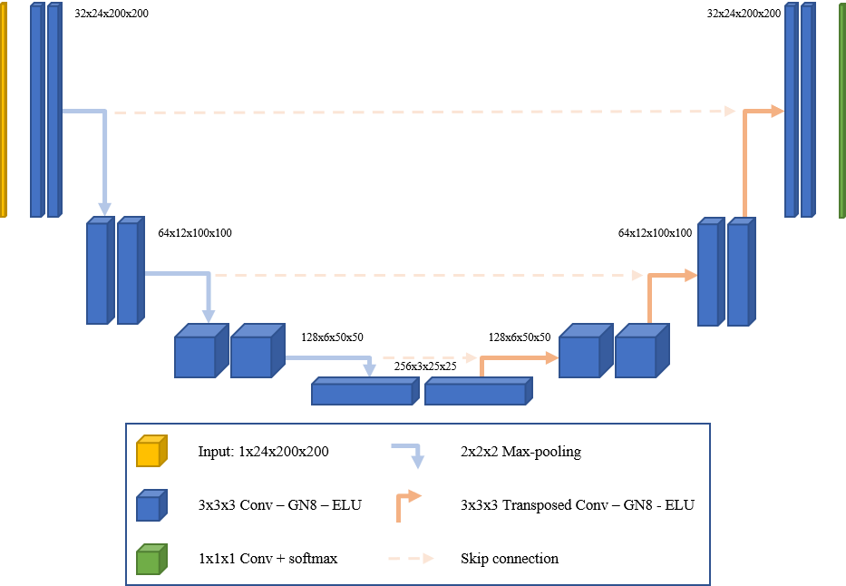
A package developed for learning-based image registration, leveraging the U-net CNN architecture.
A CNN architecture, designed for biomedical image segmentation, has proven to yield more accurate results with less training data. The architecture comprises two stages. The first stage involves the concatenation of convolution, ReLU, and pooling layers to down-sample the image. In the second stage, we up-sample and merge data from the corresponding level in the down-sampling stage. This architecture provides us with valuable spatial information and high-resolution images.
Data Augmentation
Our Network
VoxelMorph
Unet

Slide 15
Unet
A CNN architecture, designed for biomedical image segmentation, has proven to yield more accurate results with less training data. The architecture comprises two stages. The first stage involves the concatenation of convolution, ReLU, and pooling layers to down-sample the image. In the second stage, we up-sample and merge data from the corresponding level in the down-sampling stage. This architecture provides us with valuable spatial information and high-resolution images.
Data Augmentation
Our Network
VoxelMorph

Slide 16
A CNN architecture, designed for biomedical image segmentation, has proven to yield more accurate results with less training data. The architecture comprises two stages. The first stage involves the concatenation of convolution, ReLU, and pooling layers to down-sample the image. In the second stage, we up-sample and merge data from the corresponding level in the down-sampling stage. This architecture provides us with valuable spatial information and high-resolution images.
Since there is a lack of medical data, we had to collect our own data set and apply different augmentation methods to it in order to increase the dataset size.
Data Augmentation
Our Network
VoxelMorph
Unet

Slide 17
Data Augmentation
Since there is a lack of medical data, we had to collect our own data set and apply different augmentation methods to it in order to increase the dataset size.
Our Network
VoxelMorph
Unet

Slide 18
The method we eventually decided to use is building our own neural network. The neural network we built follows the architecture of four convolution-ReLU-max pooling blocks followed by three linear-RelU blocks and a final linear layer that outputs five values representing the affine transformation parameters. We then used the parameters to find the affine transformation matrix and output the transformation parameters and the original input image transformed by the affine matrix. During the training process, we used both real ”back” images and ”left” images which were transformed into a lying position. We trained our network on both fake and real images as well as the transformation given by the network. Our goal is that the network will output an image that is closest to the ”back” image, which will then be used for fine-tuning later.
Since there is a lack of medical data, we had to collect our own data set and apply different augmentation methods to it in order to increase the dataset size.
Data Augmentation
Our Network
VoxelMorph
Unet

Slide 19
Results
Our Network
The method we eventually decided to use is building our own neural network. The neural network we built follows the architecture of four convolution-ReLU-max pooling blocks followed by three linear-RelU blocks and a final linear layer that outputs five values representing the affine transformation parameters. We then used the parameters to find the affine transformation matrix and output the transformation parameters and the original input image transformed by the affine matrix. During the training process, we used both real ”back” images and ”left” images which were transformed into a lying position. We trained our network on both fake and real images as well as the transformation given by the network. Our goal is that the network will output an image that is closest to the ”back” image, which will then be used for fine-tuning later.
The most prosperous approach involved the development of a custom network tailored to the unique dataset we amassed during the course of this research.
Data Augmentation
VoxelMorph
We compared three types of results.
A fixed transformation that rotates the original image by 90 degrees.
An image based on the original image that was transformed using the parameters learned by the network.
The result image of the network.
We evaluated the outcomes by utilizing the Mean Squared Error (MSE) and the Normalized
Cross-Correlation (NCC) to compare them against the original ”back” image. Through this comparison conducted on our test set, we determined that the ”net-grid sample,” as depicted in the Figure above, yielded the most favorable outcomes in terms of both criteria.
Unet
Detailed Description of the Proposed Research

Slide 20
Results
Our Network
The method we eventually decided to use is building our own neural network. The neural network we built follows the architecture of four convolution-ReLU-max pooling blocks followed by three linear-RelU blocks and a final linear layer that outputs five values representing the affine transformation parameters. We then used the parameters to find the affine transformation matrix and output the transformation parameters and the original input image transformed by the affine matrix. During the training process, we used both real ”back” images and ”left” images which were transformed into a lying position. We trained our network on both fake and real images as well as the transformation given by the network. Our goal is that the network will output an image that is closest to the ”back” image, which will then be used for fine-tuning later.
The most prosperous approach involved the development of a custom network tailored to the unique dataset we amassed during the course of this research.
We compared three types of results.
A fixed transformation that rotates the original image by 90 degrees.
An image based on the original image that was transformed using the parameters learned by the network.
The result image of the network.
We evaluated the outcomes by utilizing the Mean Squared Error (MSE) and the Normalized
Cross-Correlation (NCC) to compare them against the original ”back” image. Through this comparison conducted on our test set, we determined that the ”net-grid sample,” as depicted in the Figure above, yielded the most favorable outcomes in terms of both criteria.
Our approach involves a multiscale coarse-to-fine image registration. The first stage is a Coarse – Posture to Posture (P2P) registration, which addresses the significant patient's MRI-Mammogram postures variability. The second stage is a Fine – Lesion to Lesion (L2L) registration, which allows for more accurate and local non-rigid lesion registration, fine-tuning the coarse one.
Detailed Description of the Proposed Research

Slide 21
Thank You!

